Slide 1
FYP 2019 - 2020
PREDICTING ONLINE TRANSACTION FRAUDS USING MACHINE LEARNING

Slide 2
GROUP MEMBERS:
Magilan S - 16BLC1005
Ashish Kumar Sahu - 16BLC1077
GUIDE:
Dr. Suganthi K

Slide 3
INTRODUCTION
Credit card fraud is a wide-ranging term for theft and fraud committed using or involving a payment card, such as a credit card or debit card, as a fraudulent source of funds in a transaction.
Although incidences of credit card fraud are limited to about 0.1% of all card transactions, they have resulted in huge financial losses as the fraudulent transactions have been large value transactions.

Slide 4
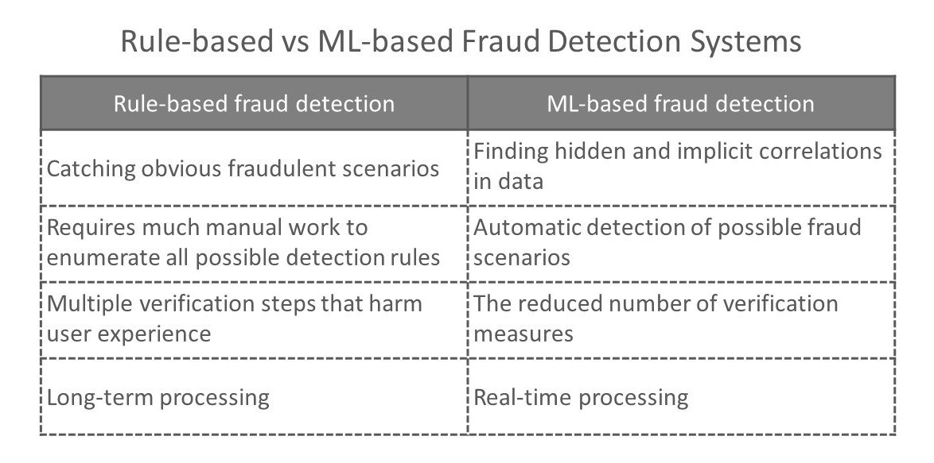

Slide 5
RULE BASED FRAUD DETECTION
False positives:
Using lots of rules tends to result in a high number of false positives - meaning you’re likely to block a lot of genuine customers.
Fixed outcomes:
The thresholds for fraud behaviour can change over time - if your prices change, the average order value can go up, meaning that orders over $500 become the norm, and so rules can become invalid.

Slide 6
OBJECTIVE
Objective of this project is to come up with a system to detect the fraudulent online transaction while the transaction is taking place.
And build an application to increase security and to prevent the frauds.
And come up with a statistical model to deal with the imbalanced classifier.
Analysis of the statistical models.

Slide 7
LITERATURE SURVEY
AUTHORS | TOPIC | PUBLICATON | YEAR
Sam Maes, Karl Tuyls, Bram Vanschoenwinkel | Credit card fraud detection using Bayesian and neural networks
Yufeng Kou , Chang-Tien Lu , S. Sirwongwattana , Yo-Ping Huang | Survey of fraud detection techniques | IEEE | 2004
Yusuf Sahin, Serol Bulkan, Ekrem Duman | A cost-sensitive decision tree approach for fraud detection | Elsevier | 2013
Jon T.S.Quah, M. Sriganesh | Real-time credit card fraud detection using computational intelligence | Elsevier | 2007

Slide 8
SURVEY | INFERENCE
Survey 1 | This paper implements the model, which gives us the probability of the fraudulent transaction.
Survey 2 | This paper presents a survey of current techniques used in credit card fraud detection. The goal of this paper is to provide a comprehensive review of different techniques to detect frauds.
Survey 3 | Each fraud is assumed to have a different misclassification cost. This approach can prioritize frauds according to their misclassification costs.
Survey 4 | This paper focuses on real-time fraud detection and presents a new and innovative approach in understanding spending patterns to decipher potential fraud cases.

Slide 9
BINARY CLASSIFIER
The classification problem involves creating models that can properly classify transactions as either legit or fraudulent.
Based on transaction details such as amount, merchant, location, time and others.

Slide 10
PROBLEMS FACED
Enormous Data is processed every day and the model build must be fast enough to respond to the scam in time.
Imbalanced Data i.e most of the transactions(99.8%) are not fraudulent which makes it really hard for detecting the fraudulent ones
Data availability as the data is mostly private.
Misclassified Data can be another major issue, as not every fraudulent transaction is caught and reported.

Slide 11
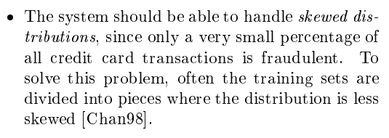
IMBALANCED CLASSIFIER

Slide 12
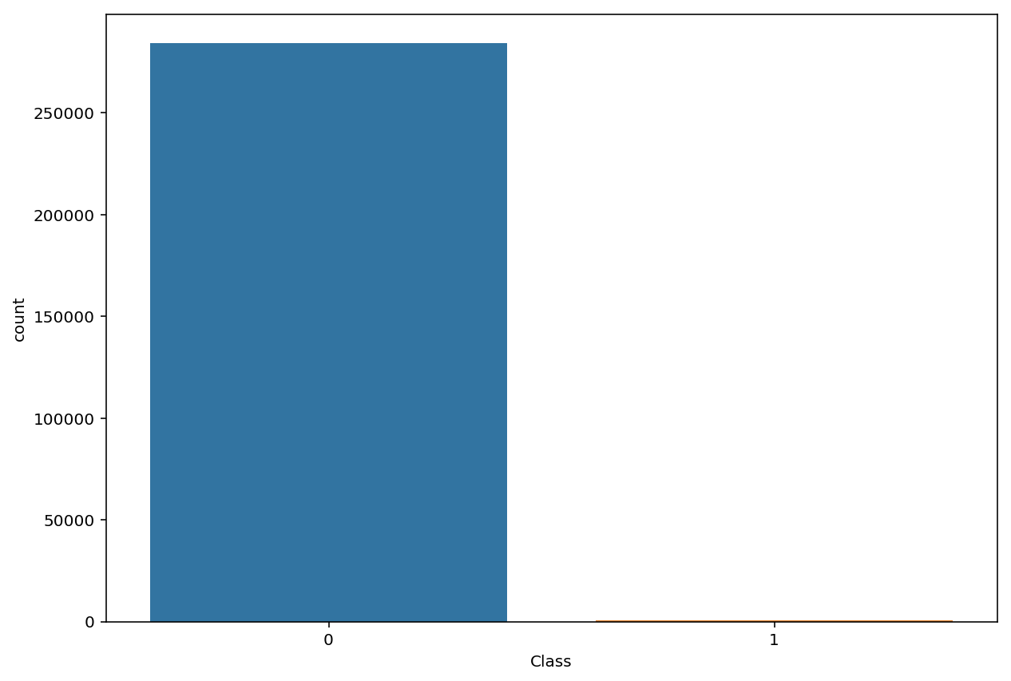
Count of fraud and genuine transactions

Slide 13
PREVENTIVE MEASURES
There are many ways of dealing with imbalanced data.
Oversampling — SMOTE
Undersampling — RandomUnderSampler
Combined Class Methods — SMOTE + ENN

Slide 14
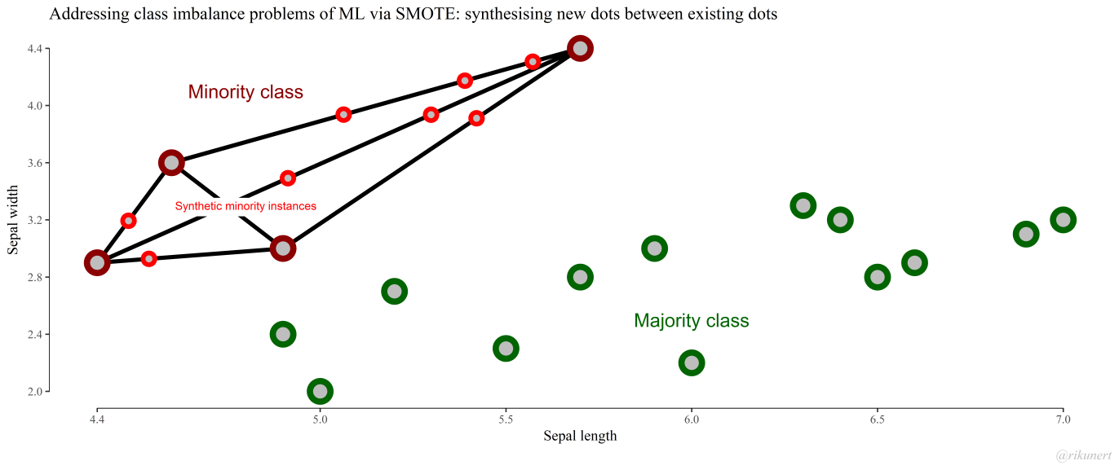
SMOTE (Over sampling)
SMOTE synthesises new minority instances between existing
SMOTE then imagines new, synthetic minority instances somewhere on these lines.

Slide 15
Under Sampling
Random undersampling:
Randomly remove samples from the majority class, with or without replacement. This is one of the earliest techniques used to alleviate imbalance in the dataset, however, it may increase the variance of the classifier and may potentially discard useful or important samples.

Slide 16
MODELS
Logistics Regression
Naïve Bayes
Decision Tree
Random Forest
Gradient Boosting
Artificial Neural Networks (ANN)
SVM with different kernels

Slide 17
MODEL VALIDATION
Recall: ability of a classification model to identify all relevant instances.
Precision: ability of a classification model to return only relevant instances
F1 score: single metric that combines recall and precision using the harmonic mean

Slide 18
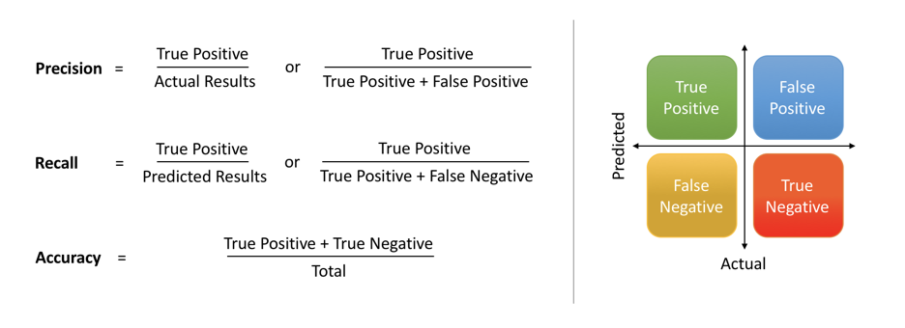

Slide 19
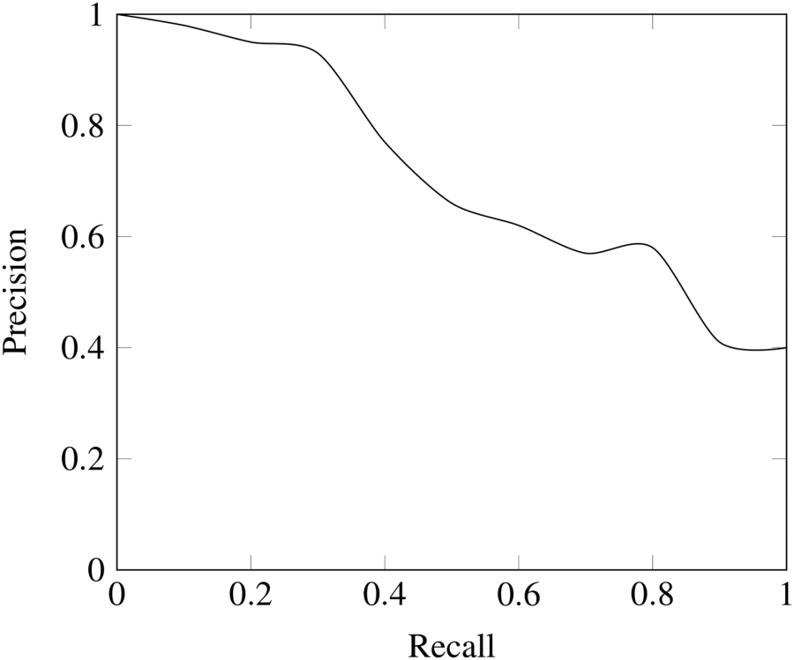
PRECISION VS RECALL

Slide 20
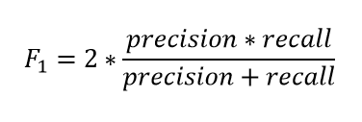
F1 SCORE
The F1 score is the harmonic mean of precision and recall taking both metrics into account in the following equation:

Slide 21
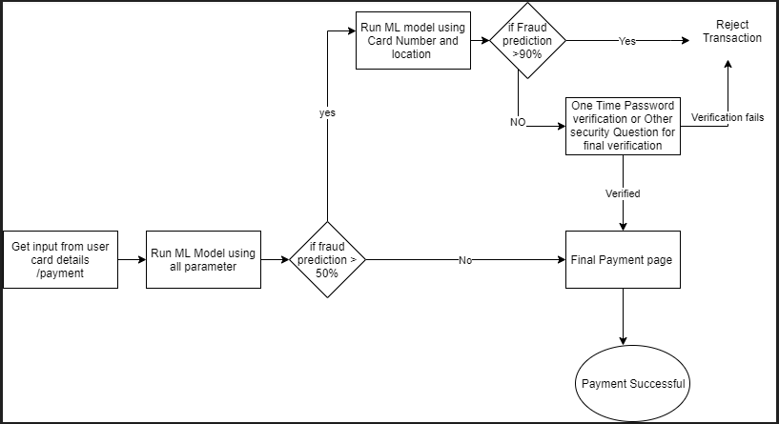
APPLICATION FLOWCHART

Slide 22
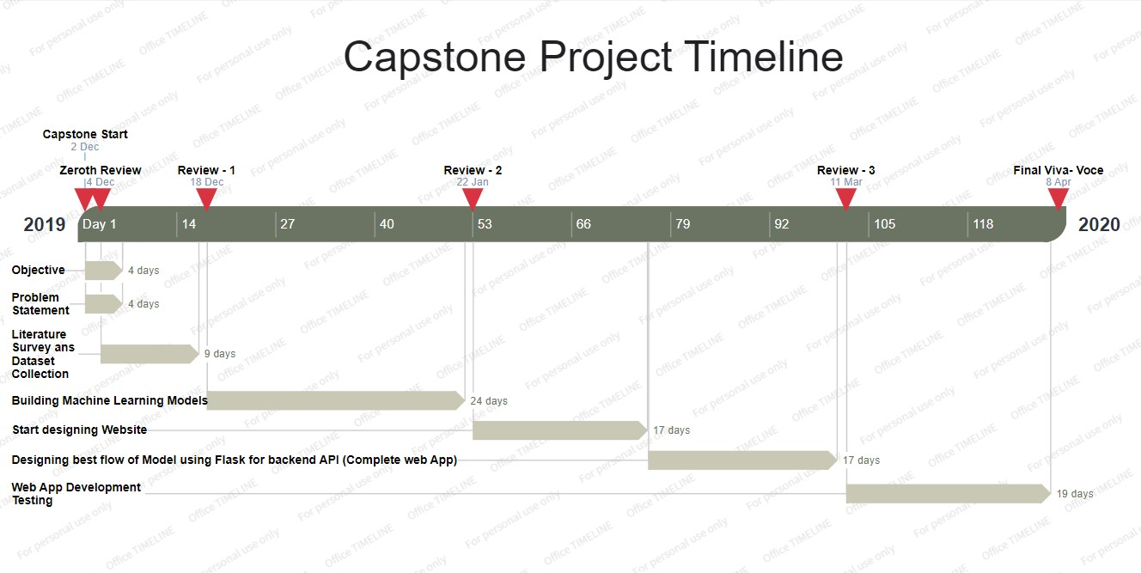
TIMELINE

